Slide 1
Comparing Compute Options for Microservices on AWS
Arun Gupta
Principal Open Source Technologist, Amazon Web Services

Slide 2
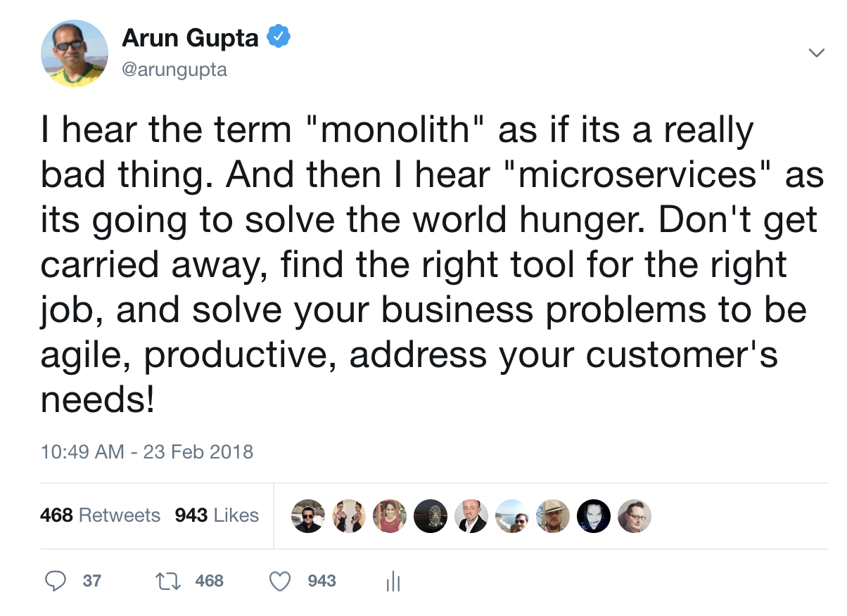

Slide 3
A Typical Application with Microservices
Client
Webapp
Webapp
Webapp
Greeting
Name
Greeting
Name
Greeting
Name

Slide 4
Microservices and Containers
Do one thing, really well
Any app, any language
Test and deploy same artifact
Self-contained services
Isolated execution environment
Faster startup
Scaling and upgrading

Slide 5


Running Containers
EC2 Instance
EC2 Instance
EC2 Instance
EC2 Instance
EC2 Instance
Notes:
Or if you want to run containers in the cloud, you spin up some EC2 instances, launch containers on them and get going in minutes. This would work even if you are using dozens of containers. But as you think about scaling this, managing hundreds of such instances, monitoring their health, scaling them and launching your containers on them and the whole lifecycle around them…how do you scale for that?

Slide 6
Running Containers at Scale
Scheduling and Orchestration
Cluster Manager
Placement Engine
Availability Zone #1
Availability Zone #2
Availability Zone #3
Notes:
So lets say you plan to run several highly available applications across 3 different availability zones.
[CLICK]
ECS enables you to be able to operationalize your containerized workloads at very high scales. No management software to install or worry about its high availability.
The cluster management piece enabled you to be able to monitor the cluster, scale it using autoscaling groups and be able to manage state of the instances in the cluster.
The placement engine enables you to be able to set rules to target landing your containers on the right instances based on your preferences.
And then finally, the advanced scheduling features help maintain the desired state of the application, spawn new containers to automatically respond to scaling needs and maintain resiliency by deploying across multiple availability zones while being resource aware of the underlying compute.

Slide 7




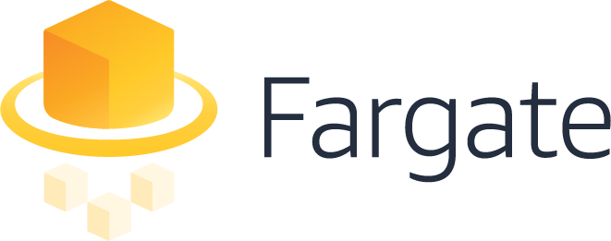



Running Containers on AWS
Using Managed Services
(coming soon)
Notes:
It was just over 3 years ago that we announced the release of Amazon Elastic Container service We launched ECS because our customers needed a way to manage and scale the deployment of Docker containers on AWS. Our customers wanted a managed service where they didn’t have to operate their own cluster management software, a solution that was scalable and secure that they could trust to run their production workloads, and they wanted tight integration and support for EC2 features that they liked.
Then in 2015, we focused on building a highly reliable, and performant docker image registry and announced this GA release near the end of 2015. Our goal with ECR was to enable developers to use the same familiar docker push/pull APIs to store their container images and we see this product highly adopted by customers both running containers on AWS and really across any environment.
What have we learned since then?

Slide 8
Running Containers with ECS
Notes:
So let’s talk about how to use FARGATE with ECS. You want to think about Fargate as a technology and not a different service per se when using it with ECS. I.e. no new APIs to learn.
[CLICK]
Here’s a screenshot of ECS when you define an application (called a Task Definition), you are presented with an option to select compatibilities with a launch type – Fargate is just a launch type. If you want to run your containers on the EC2 Instances registered with your ECS cluster, that is the EC2 Launchtype.
====================
For example a runtask command has a new launchtype: ecs run-task --launch-type FARGATE --cluster fargate-test --task-definition nginx --network-configuration "awsvpcConfiguration={subnets=[subnet-b563fcd3]}"

Slide 9

Amazon ECS CLUSTER
Subnet 1
Subnet 2
Subnet 3
172.31.1.0/24
172.31.2.0/24
172.31.3.0/24
Web
FARGATE
Shopping Cart
ECS Instance
ECS Instance
ECS Instance
ECS Instance
ECS Instance
ECS Instance
Notifications
EC2
Availability Zone #1
Availability Zone #2
Availability Zone #3
Notes:
Fargate clusters are heterogeneous.
Say you have different requirements where the notifications app team would like to be able to move to Fargate but has a different timeline planned to do so but are ready to use Fargate for your Shopping cart and web apps.
[CLICK]
As you notice, you can run the Web and shopping cart apps as ECS services with launch type Fargate and you only see your tasks across the various subnets and AZs. You can continue to run Shopping Cart and Notifications apps as EC2 Launch Types within the same cluster as the Fargate powered Web app and network boundaries thereby applying uniform set of policies in terms of IAM permissions as well as network access rules.
Notice, how the containers are spread across different subnets across AZ. This gives high resiliency and fault tolerance to your microservices.

Slide 10
Deploying Microservices
using
AWS Fargate

Slide 11
EKS Core Tenets
Platform to run production-grade workloads
Native and upstream Kubernetes experience
Seamless integration with EKS services
EKS team actively contributes upstream

Slide 12
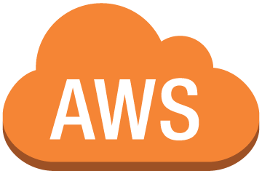

Kubectl
mycluster.eks.amazonaws.com
Availability
Zone 1
Availability
Zone 2
Availability
Zone 3
Notes:
Now, with EKS, the complexity of standing up your own Kubernetes control plane is simplified. Instead of running the Kubernetes control plane in your account, you connect to a managed Kubernetes endpoint in the AWS cloud. This endpoint abstracts the complexity of the Kubernetes control plane- your worker nodes can check into a cluster, and you can interact with your Kubernetes cluster through the tooling you already know and love.

Slide 13
Application Deployment using Helm on Kubernetes
Mychart
|-- Chart.yaml
|-- charts
|-- templates
| |-- NOTES.txt
| |-- _helpers.tpl
| |-- deployment.yaml
| |-- ingress.yaml
| `-- service.yaml
`-- values.yaml
Templating and packaging tool for k8s apps
Chart: Bundle to represent k8s apps
Analogous to apt, yum, homebrew for k8s

Slide 14

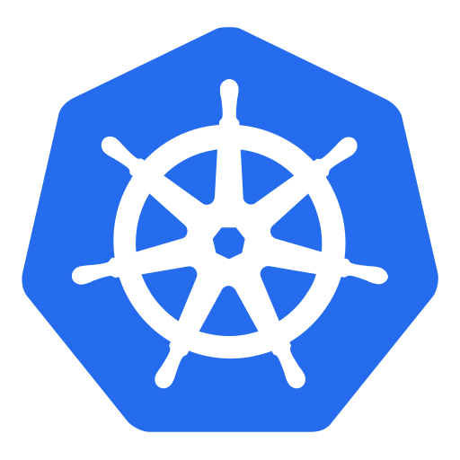

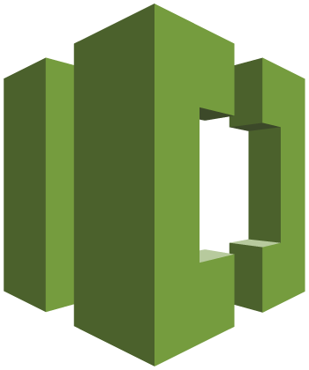
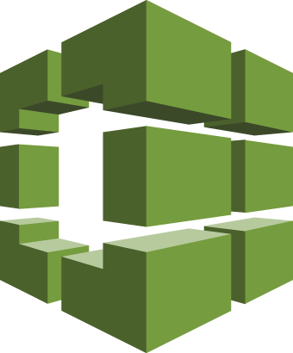
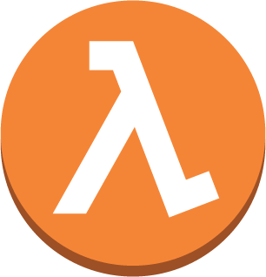

AWS CodePipeline – CI/CD with Kubernetes
6
1
Developers continuously integrate changes into a main branch hosted within a repo
Amazon ECR
2
Triggers an execution of the pipeline when a new version is found, builds a new image with build ID
3
5
3
Pushes the newly built image tagged with build ID to ECR repo
4
Invokes a Lambda function to trigger application deployment
1
2
4
5
Leverages Kubernetes Python SDK to update a deployment
Developer
AWS CodeCommit
AWS CodeBuild
AWS Lambda
6
Fetches new container image and performs a rolling update of deployment
AWS CodePipeline

Slide 15
Deployment Pipeline
for
Microservices using Kubernetes

Slide 16
















Spectrum of Serverless at AWS
“On EC2”
Managed
Serverless
Amazon EMR
Amazon ES
AWS
Lambda
Amazon Cognito
Amazon Kinesis
Amazon EC2
Amazon S3
Amazon DynamoDB
Amazon SQS
Amazon ElastiCache
Amazon Redshift
Microsoft SQL Server
Amazon RDS
Amazon API Gateway
Amazon CloudWatch
AWS IoT
Notes:
Provide context on Region & AZ – 16 regions & 52 AZ
To make HA, On EC2, you need to deploy across different AZ. On Managed, there is an option for multi-AZ. In Serverless, everything (HA & Fault tolerance) is taken care of for you.
First service was S3 and SQS – Serverless services. Lambda was added as Compute to S3 because of customer feedback. And then we added other sources to Lambda.
Provides a wide spectrum of services from Chatbot, IT automation, web application, Alexa and many others. We’ll look at a few of those today.

Slide 17

Serverless Application Model
CloudFormation extension optimized for Serverless
New serverless resource types: functions, API and tables
Supports anything CloudFormation supports
Open specification (Apache 2.0)
https://github.com/awslabs/serverless-application-model

Slide 18
Deployment using AWS Lambda
/greeting
/webapp
greeting
webapp
/names/1
name

Slide 19
Microservices Deployment
using
Serverless Application Model

Slide 20
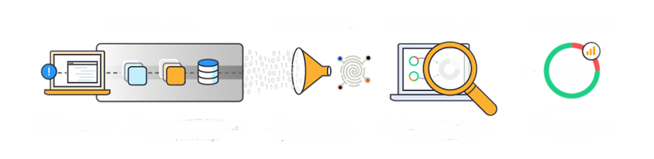
X-Ray Service
Notes:
X-Ray helps you with tracing requests, record the traces in the X-Ray service, view service map of your distributed application in the X-Ray console and analyze specific issues that are affecting your application within a specific time frame.

Slide 21
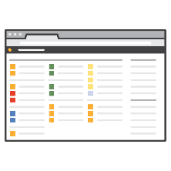








X-Ray Workflow
X-Ray Console
DevOps Team
HTTPS
Localhost
UDP
Localhost
UDP
HTTPS
App & X-Ray
SDK
App & X-Ray
SDK
HTTPS
X-Ray API
AWS
Credentials
X-Ray
Daemon
X-Ray
Daemon
EC2 Role
On-prem Server
EC2 Instance/Containers/Lambda
Notes:
The X-Ray daemon listens on UDP. It receives data from the SDK over UDP and acts as a local buffer. Data is flushed to the backend every second or when the local buffer fills. Daemon available for Amazon Linux AMI, RHEL, Ubuntu, OS X, and Windows.
Daemon talks to the X-Ray API/service over HTTPS.
You can use X-Ray on your on-prem servers by running the X-Ray daemon as well.
You can then view and analyze performance of your distributed application in the X-Ray console.

Slide 22
Monitoring Microservices
Using
AWS X-Ray

Slide 23
github.com/ aws-sample/ aws-microservices-deploy-options

